Slide 1
Storytelling with Data (The Art of Visualization)
Welcome
Week 3. Static and Interactive Data visualization
20 September 2023

Slide 2
For Today
(15 minutes): Recap week 2
(30 Minutes): Static and interactive Data Visualization, study some examples
(30 Minutes): Introduce the Group Work (Juicy Fruit Corporation)
(60 Minutes): Group work: dive into the dataset, formulate KPI’s, start defining context (use Ch1).
(After class): try out the Python scripts for Geo map and Dashboard app.

Slide 3
Weekly Program

Slide 4
Week 3 Learning goals
At the end of this course, the student must be able to:
Understand static versus interactive visualization
Learn interactive visualization using Python packages
Implement both types of visualization using the Juicy Fruit Corporation data

Slide 5
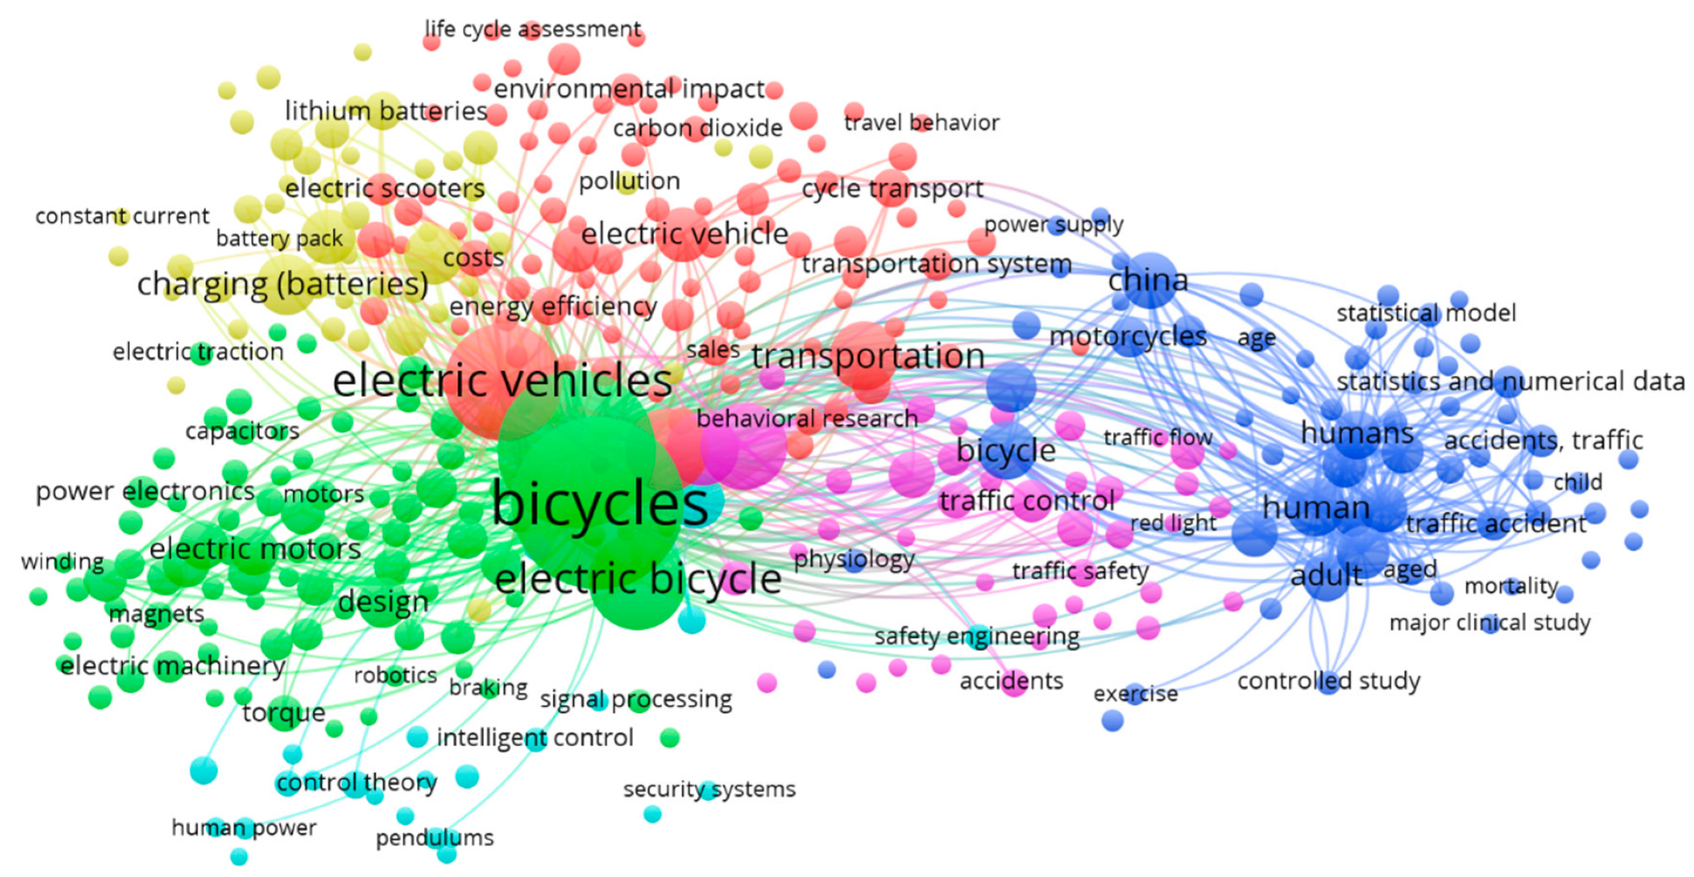
Static Visualization
Source: Salmeron-Manzano & Manzano-Agugliaro 2018
Notes:
Static visualizations are commonly seen as infographics posted on the web or printed as handouts. Usually focused on a specific data story, users can’t go beyond a single view to explore additional stories beyond what’s in front of them. The story is specifically captured in an engaging single page layout.
All kinds of visuals that we learn in the previous week can be made into static and interactive visual.

Slide 6
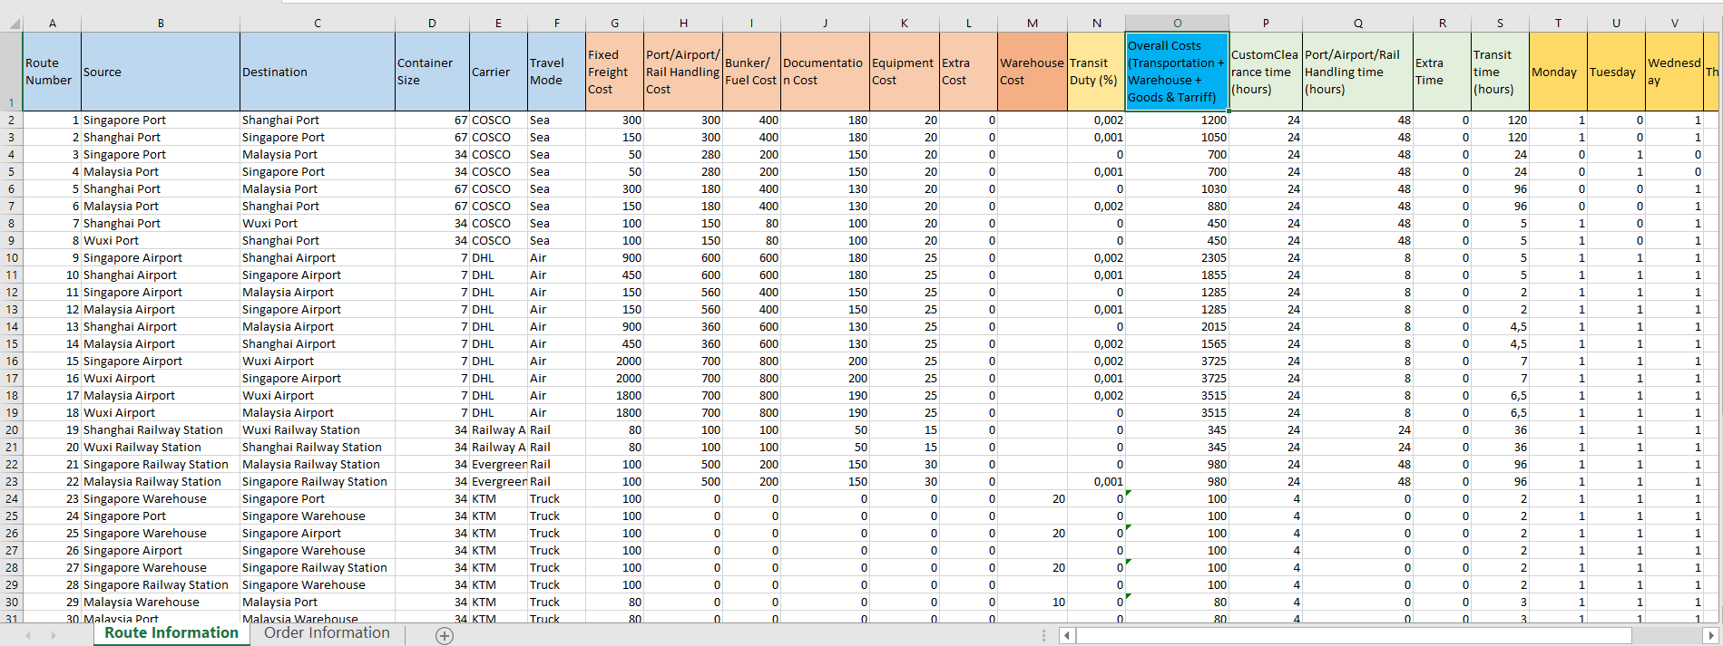

Slide 7
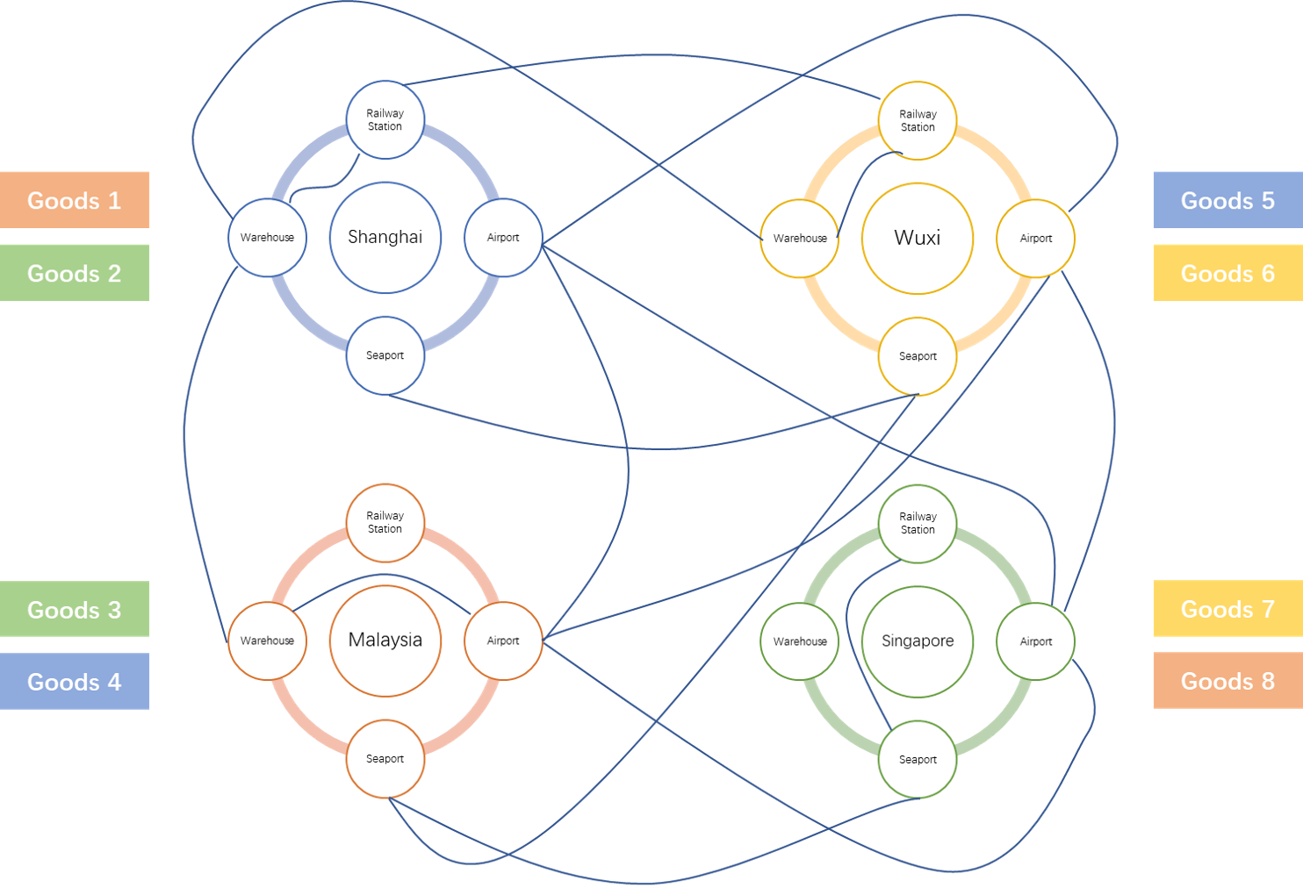
GitHub - hzjken/multimodal-transportation-optimization: A project on using mathematical programming to solve multi-modal transportation cost minimization in goods delivery and supply chain management.

Slide 8
Interactive Visualization
Interactive visualizations are commonly seen on the web only as applications.
Users can select specific data points to build a visualized story of their choosing.
Better known as Data Visualization Apps, these visualizations allow the user to be part of the data visualization process by building a story of their choosing.

Slide 9
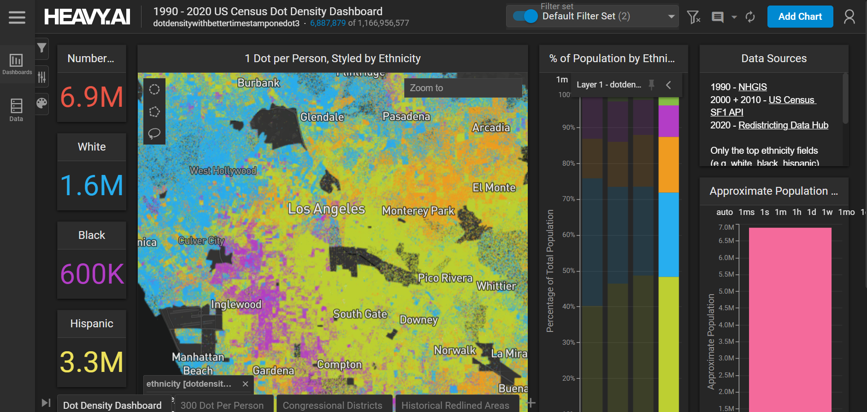
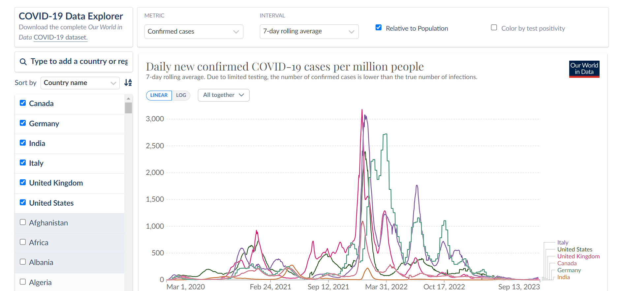
Interactive visualizations examples
Diversity by location in the US
COVID-19 dashboard

Slide 10
Interactive visualizations: exercise
With your neighbor:
Study the two examples on the previous slide. Follow the link to access the dashboards.
Try out how the dashboards work, note down things you have found out (like: what is the most common ethnicity in Los Angeles? Or: until today, which country had most COVID cases in 2023?).
Note down what you find about what makes them work really well. Write about specific dashboard components
Note down what could be improved, write about specific components as well.

Slide 11
Visualization packages in Python
1. Folium (Geo-map, heatmaps)
2. Plotly express / graphic objects (Interactive bar charts, etc.)
3. Dash & Streamlit (Interactive dashboards)
… And more, these are the basics / most commonly used packages.

Slide 12
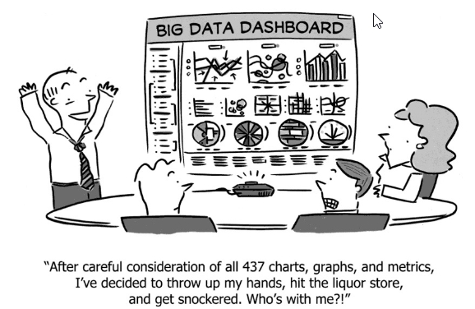
Dashboards

Slide 13


Juicy Fruit Corporation
Juicy Fruit Corporation produces semi-fresh fruit juices
Located in Eindhoven, The Netherlands
The Management would like to determine course of actions to make the company strive in the business.

Slide 14

The challenge…
A TEAM of CONSULTANTS has been hired
The mission is to inform the CEO and the management on the current status of the company and on how to make the company profitable.
The team will create visualizations to understand the current situation of each department.
Cross-relationship of the departments will be analyzed.
Recommendations to the CEO will be provided in order to improve Juicy Fruit Corporation’s situation.
The team will pitch to the CEO their findings and recommendations.

Slide 15

CRISP Model of Data Mining (Source: Wikipedia)

Slide 16

Management: 4 Departments
“planning inventory of raw materials and finished goods”
Supply Chain
Components
Finished goods
Source
Make: Mixing
Make: Bottling
Deliver
Purchasing
Operations
Sales
In-charge of suppliers
“capacity management”
“in-charge of customers”

Slide 17










Juicy Fruit Corporation Supply Chain
Inbound warehouse
Outbound warehouse
Orange
JO 1L
AHA Supermarket
Mixing
JO-L 1L
Mango
JO-M 1L
Texo
Citrus syrup
JO 300mL
Tetrapack 1L
JO-L 300mL
300 mL bottle
Mobil station
JO-M 300mL
Bottling
Overflow (external storage)
Overflow (external storage)

Slide 18
Assumptions
The data set is bi-annual (twice a year reporting from 2017-2021).
Raw material requirements to produce finished goods:
Finished goods
Pack 1 liter
300
mL
Orange
Mango
Vitamin C
Juicy orange 1L
1
0.200
Juicy orange-mango 1L
1
0.150
0.050
Juicy orange-lemon 1L
1
0.190
0.010
Juicy orange 300mL
1
0.060
Juicy orange-mango 300mL
1
0.045
0.015
Juicy orange-lemon 300mL
1
0.057
0.003

Slide 19
Assumptions
Finished goods information (for Sales, Distribution, and Warehouse usage)

Slide 20
Assumptions
Raw materials information
Raw materials
Shelf life in weeks
Pallet layer content
Pallet content
Basic price
Tetrapack 1 liter
-
-
17,280
0.030
300ml bottle
-
216
1,080
0.030
Orange
52
-
-
0.400
Mango
52
-
-
0.900
Citrus syrup
52
-
-
0.150
*Tetrapack 1L and 300mL bottle are in pieces
**Mango, Orange, and citrus syrup are measured in Liters.

Slide 21
Guide on the assignment (Visualization)
1. Using the CRISP model of data mining, analyze the dataset. Make a visualization of the key performance indicators (KPIs) for each management roles (purchasing, production, supply chain, and sales).
2. What can you conclude from the current KPIs of each department?
3. Analyze possible relationship (correlation) of at-least 2 departments (e.g. Warehouse capacity of finished goods = demand of finished goods + inventory of finished goods)
4. Provide an advice to the CEO and management of Juicy Fruit Corporation in order to improve its management processes?

Slide 22
Now: start with step 1
Using the CRISP model of data mining, analyze the dataset. Make a visualization of the key performance indicators (KPIs) for each management roles (purchasing, production, supply chain, and sales).
In your team:
Begin with developing a solid business understanding. What are important performance indicators for each manager? How does the company currently perform according to those indicators?

Slide 23
Assigment (For Next Week)
**Starting week 4, we will focus on Storytelling Part
Read pages 19-33 of the Book Storytelling with Data (The Importance of Context), Optional reading: pages 71 – 98 (Eliminating Clutter).
Practice with the interactive visualization scripts on #OO.
Continue exploring the Juicy Fruit Corporation dataset.

